Slide 1
Mlsa internship preesntation by Himanshi malik (202401200200005)

Slide 2
Introduction of MLSA KIET Chapter: The MLSA KIET Chapter, are an integral part of the Microsoft Learn Student Ambassador (MLSA) community, the world's largest Microsoft student community. Their primary objective is to deliver the latest and most comprehensive knowledge about Microsoft’s products. They provide unparalleled support and guidance to all students aspiring to pursue careers in the technology sector. The MLSA KIET Chapter is committed to training the students of KIET Group of Institutions in cutting-edge technologies, including Version Control, Generative AI, Azure Cloud Infrastructure, Microsoft 365 Suite, Power AI, Microsoft Reactor, Microsoft Cobalt, Dynamics 365, Defender MSFT and many more. Their mission is to equip students with the skills and knowledge needed to excel in the rapidly evolving tech industry. Introduction of Internship: The MLSA KIET Chapter, under the guidance of Dr. Vineet Sharma, Head of the CSE Department and Chief Patron of MLSA KIET, and Dr. Seema Maitrey, Faculty Coordinator of MLSA KIET & Mentors (Core Team) of MLSA KIET, have designed an innovative and engaging internship program for the students of KIET Group of Institutions. This program is open to first year and second-year students who wish to participate in this internship opportunities. The internship program features pre-defined modules and learning paths from Microsoft Learn, offering a comprehensive and practical approach to mastering these paths and modules. The program spans one month and is structured to provide students with hands-on experience and in-depth knowledge of various Microsoft technologies. Through this initiative, They aim to equip students with the skills and expertise needed to excel in their academic and professional pursuits.

Slide 3
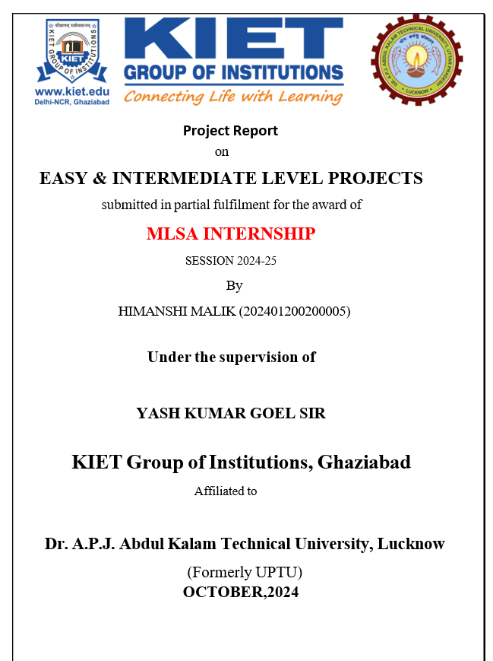
Full Stack Web Development Introduction A Full-stack Web Development Internship typically involves building dynamic, user-friendly interfaces using HTML, CSS, JavaScript, and frameworks like React. It also includes implementing server-side logic with technologies such as Node.js and managing databases with MongoDB. Interns often work on projects like e-commerce sites and online portfolios, ensuring seamless user experiences across various devices through responsive design techniques.

Slide 4
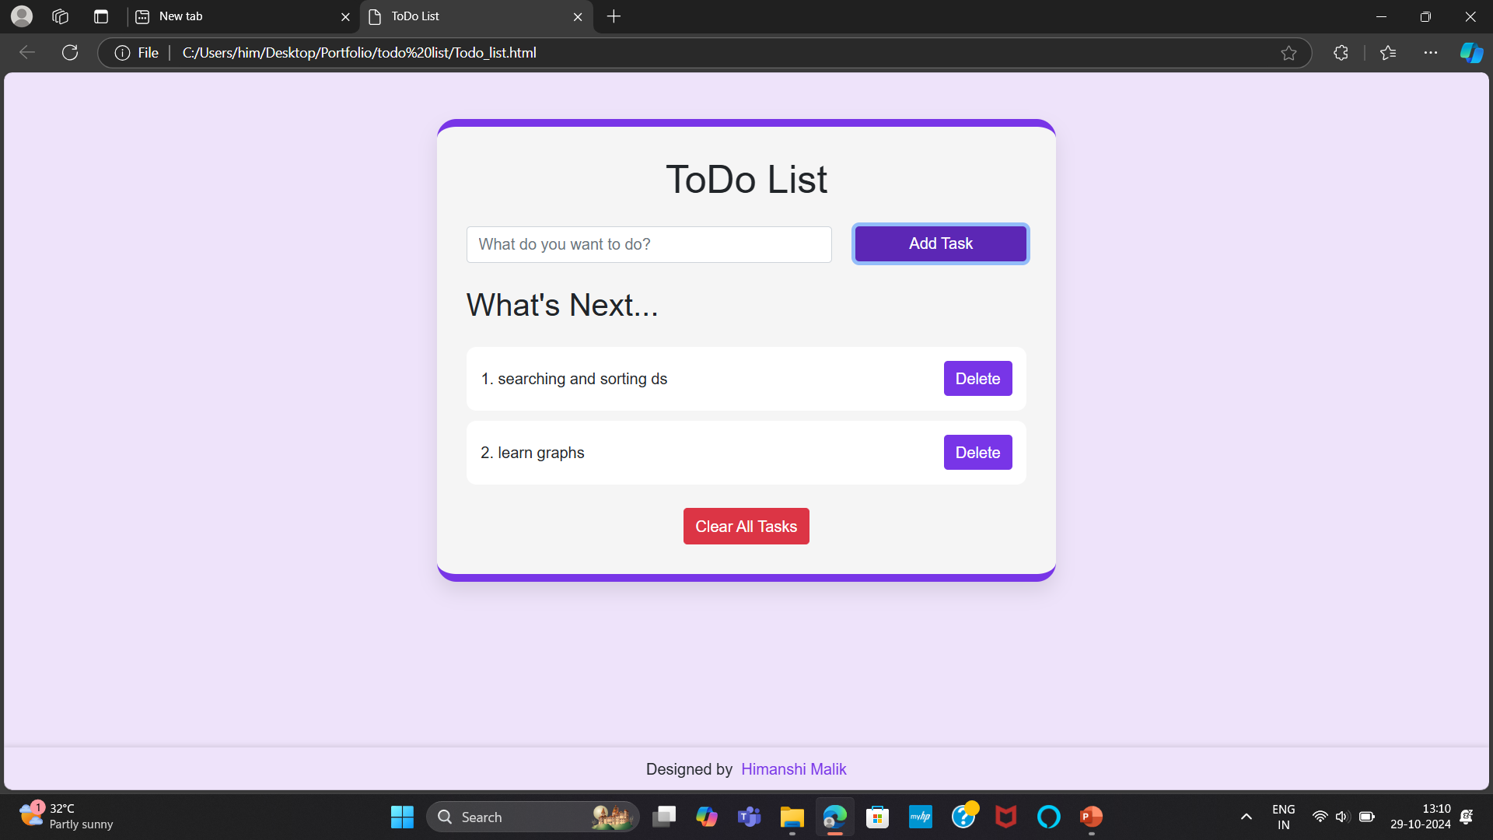
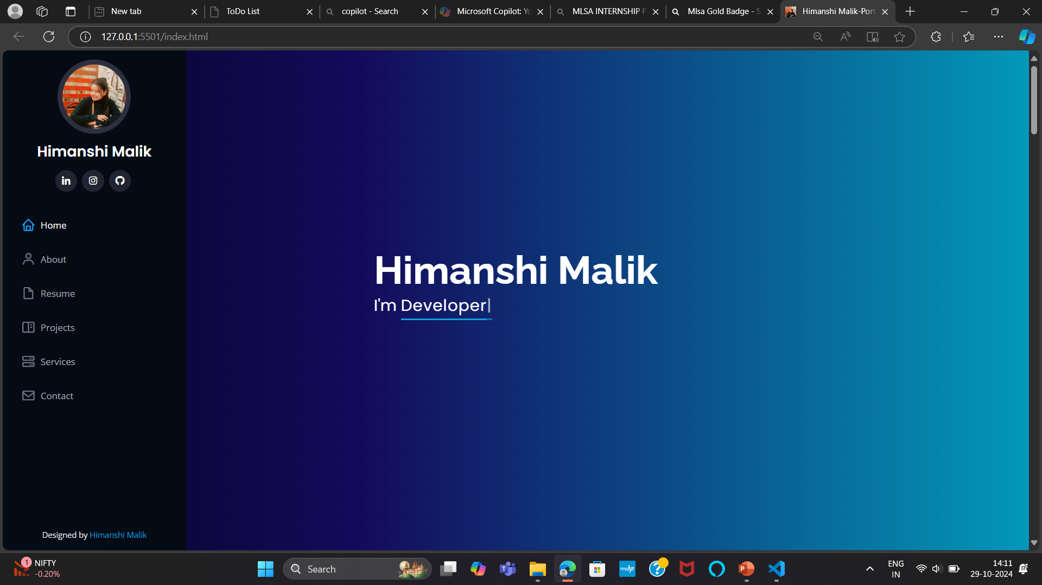
My MLSA Internship Projects
During my internship with the Microsoft Learn
Student Ambassadors (MLSA) program, I had the
opportunity to work on two projects that
significantly enhanced my web development skills.
To Do List Application (Easy Level): Developed a user-friendly application to manage daily tasks using
HTML, CSS, and JavaScript.
Portfolio Webpage (Intermediate Level): Created a comprehensive portfolio website to showcase my projects and skills, featuring responsive design and interactive elements. These projects not only provided practical experience but also allowed me to apply and expand my knowledge in front-end development.

Slide 5
Easy level project To-Do List Application Developed during MLSA Internship Program
Project Overview Content:
Developed a user-friendly To-Do List application as part of my MLSA Internship.
Built using HTML, CSS, and JavaScript to manage daily tasks efficiently.
Aimed to provide a simple, intuitive tool for task management.
Technology Stack
Title: Technology Stack Content:
HTML: Structured the application’s layout.
CSS: Styled the application to enhance user experience.
JavaScript: Added interactivity and functionality.

Slide 6
Objectives CReate an application that allows users to manage their tasks effectively. Include features like adding, deleting, and marking tasks as completed. Implementation HTML: Structured the core elements such as the task input field and task list. CSS: Styled the application using classes and IDs, focusing on a clean and modern look. JavaScript: Developed functions to handle adding, deleting, and completing tasks. Used event listeners to capture user actions.
LEARNING OUTCOME
Gained hands-on experience in front-end development and JavaScript.
Improved skills in creating responsive and user-centric interfaces.

Slide 7
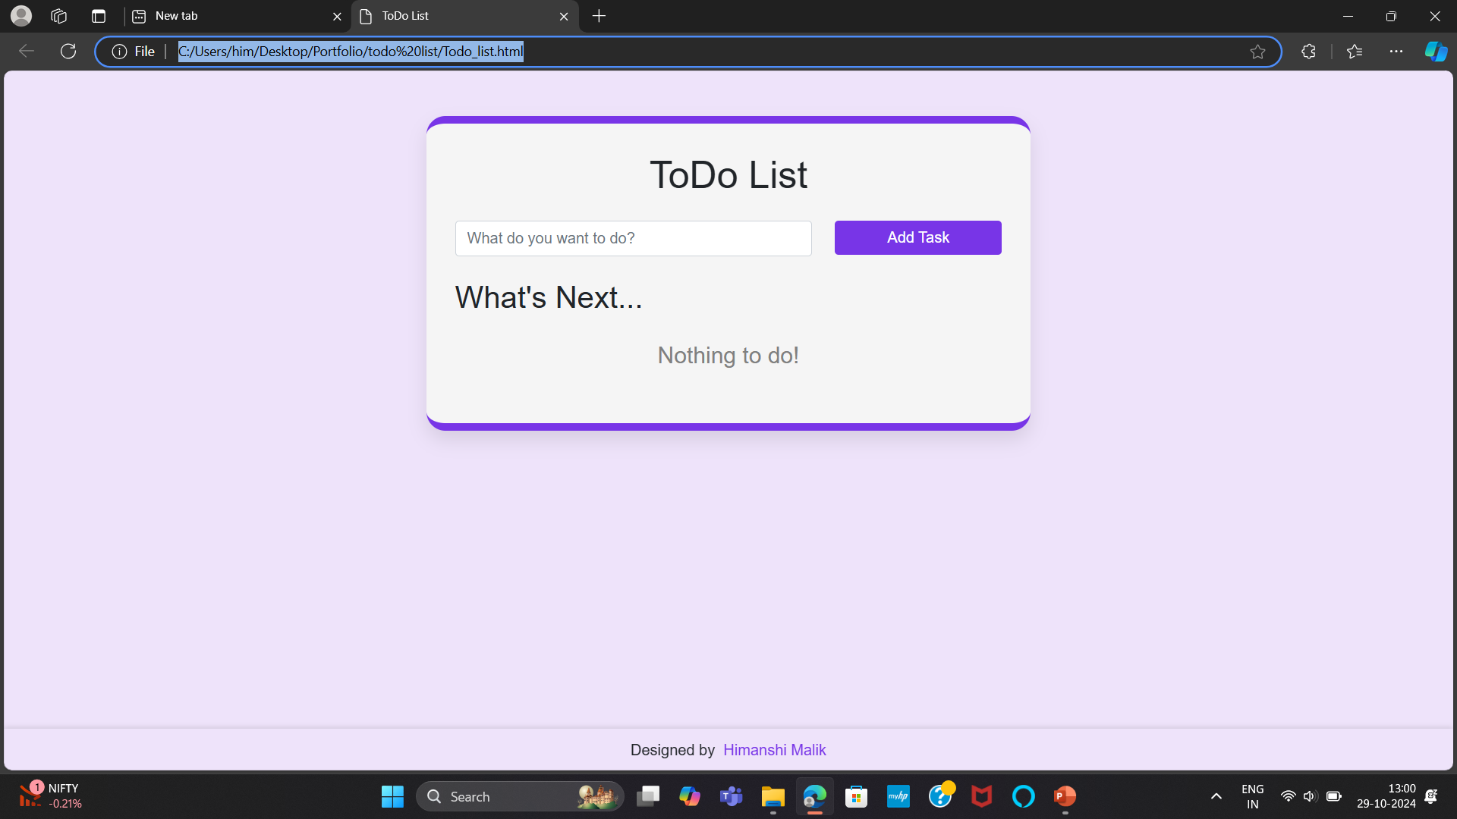
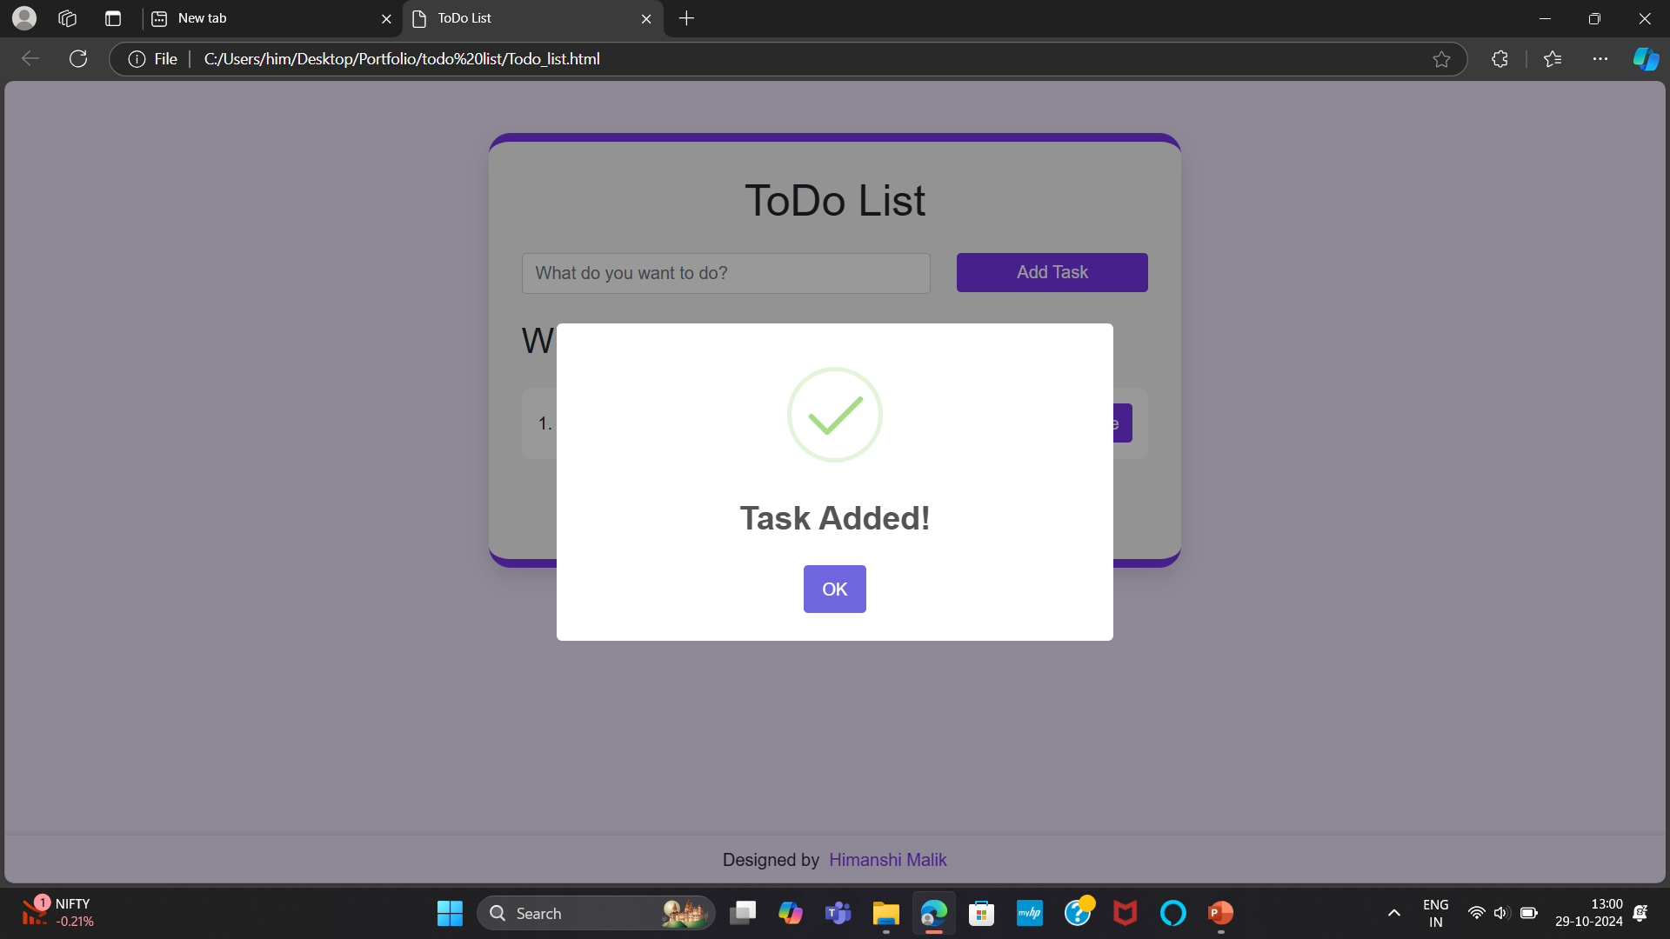
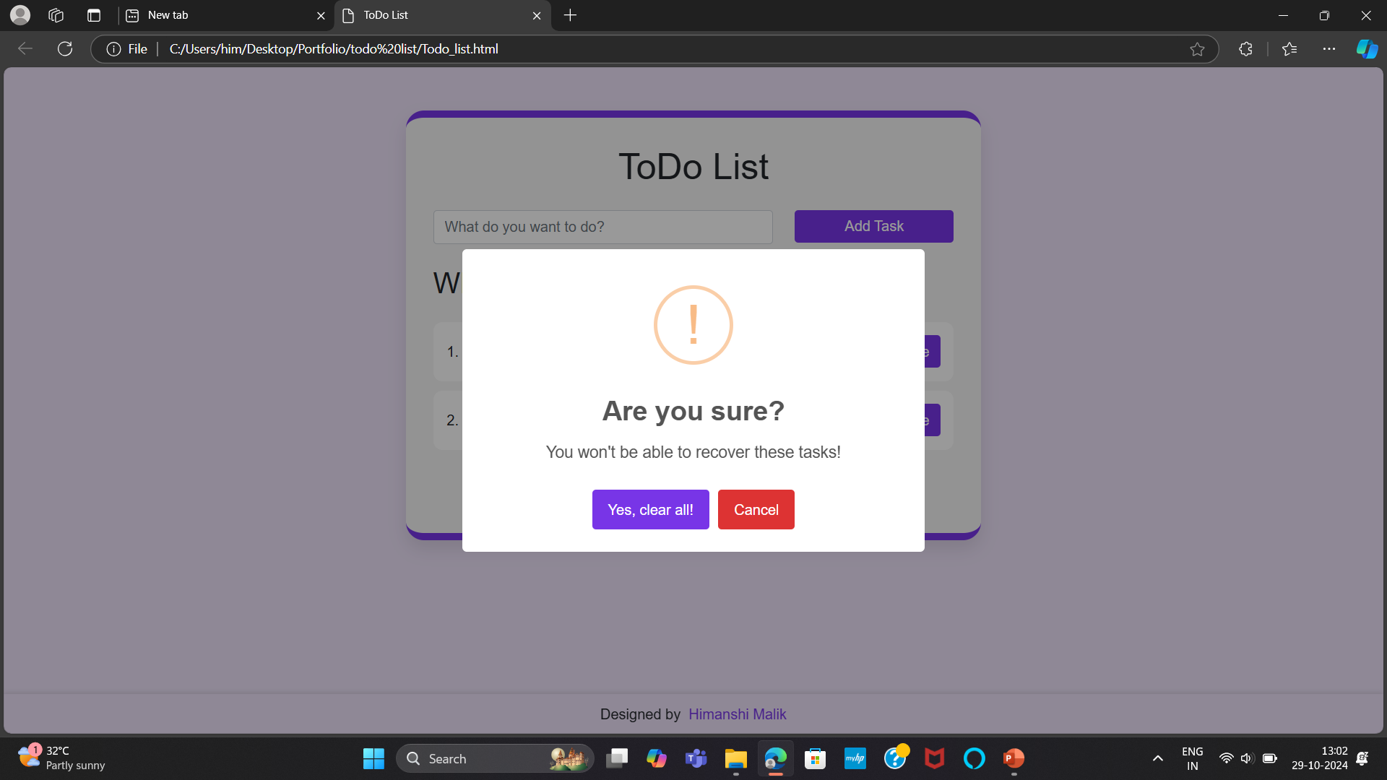
SNAPSHOTS
STEP 3:
STEP 1:
STEP 2:
STEP 4:

Slide 8
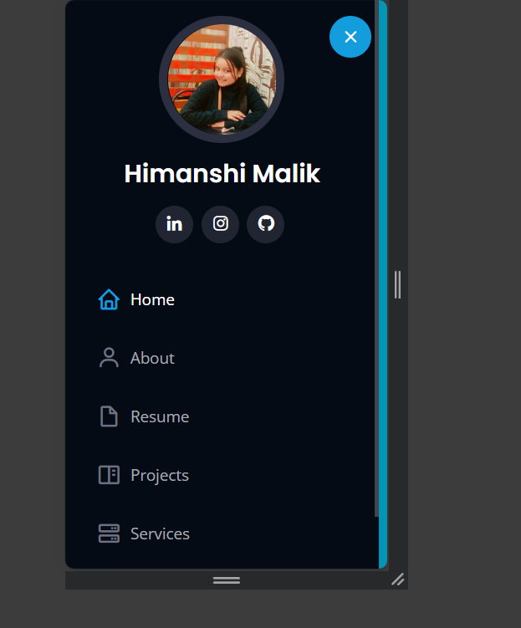
intermediate level project: Portfolio Website Developed during MLSA Internship Program
Introduction
Developed a personal portfolio website to showcase my projects and skills.
Built using HTML, CSS, and JavaScript during the MLSA Internship.
Objectives
To demonstrate my web development skills through a live project.
To create a platform to display my projects, resume, and contact information.
Ensure the website is responsive and accessible across all devices.
Technology Stack
HTML: Structured the content and layout of the website.
CSS: Styled the website for a professional and cohesive look.
JavaScript: Added interactive elements and functionalities.

Slide 9
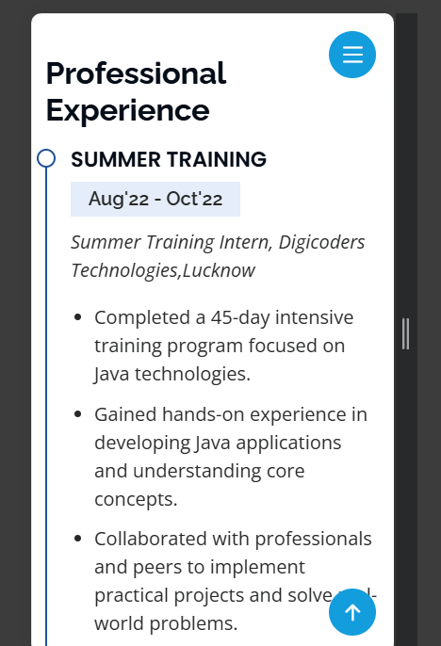
FEATURES
About Me: Introduction section with background information.
Projects:Gallery showcasing various projects with descriptions and links
Contact Form: Form allowing visitors to get in touch.
Services: Section listing out the type of services being provided.
Resume: A detailed resume highlighting my academic background, technical skills, and professional experience.
Responsive Design: Ensured the website looks great on all devices.

Slide 10
Development Process
1. Planning: Defined the structure and content for the portfolio. Created wireframes and mockups. 2. Design: Selected a color scheme and typography. Designed the layout focusing on usability and aesthetics. 3. Implementation: HTML: Structured the webpage into sections (About Me, Projects, Contact). CSS: Applied styles to enhance visual appeal and usability. JavaScript: Added interactivity, such as form validation and smooth scrolling. 4. Testing: Conducted cross-browser and device testing. Ensured responsive design and accessibility. 5. Deployment: Deployed the website on a web server for public access.

Slide 11
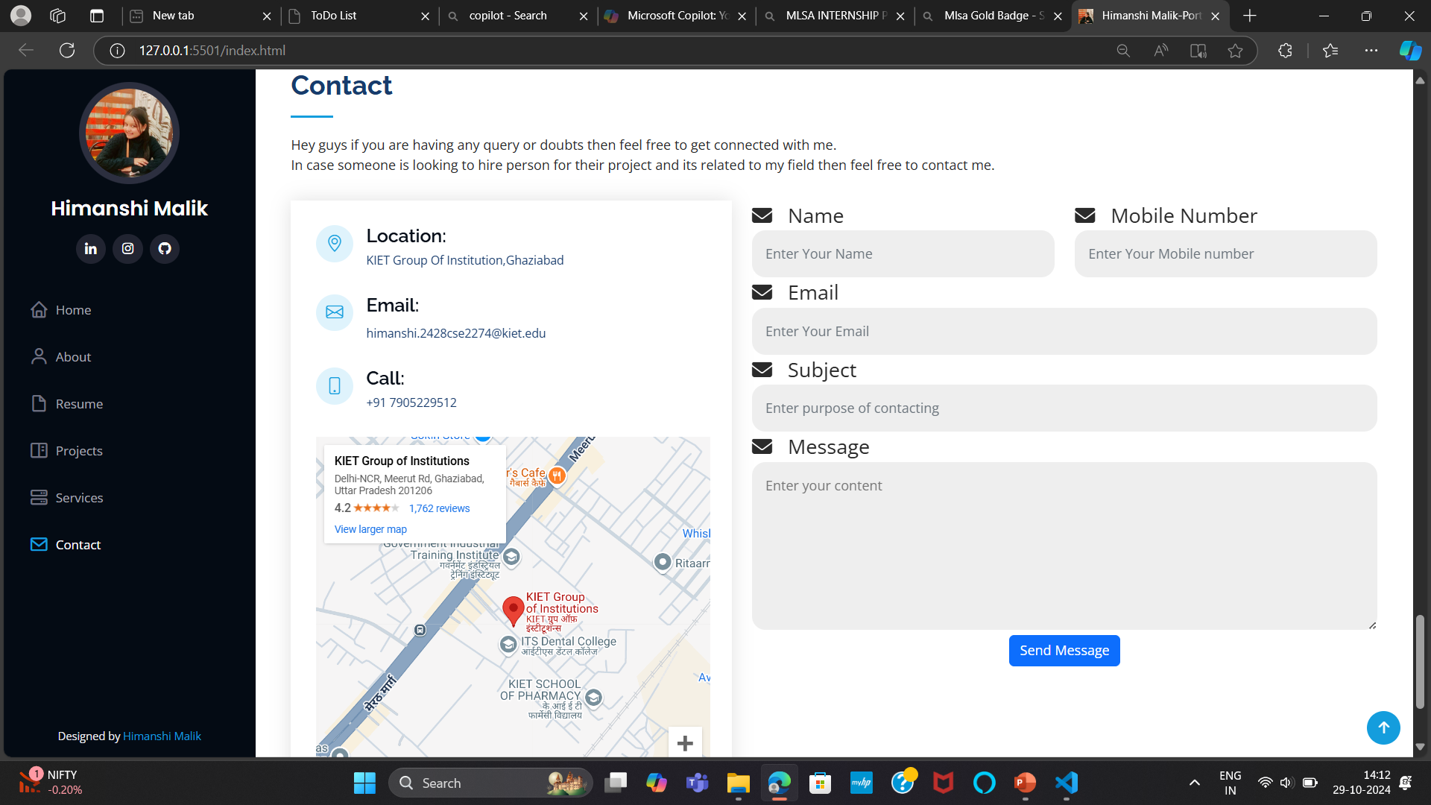
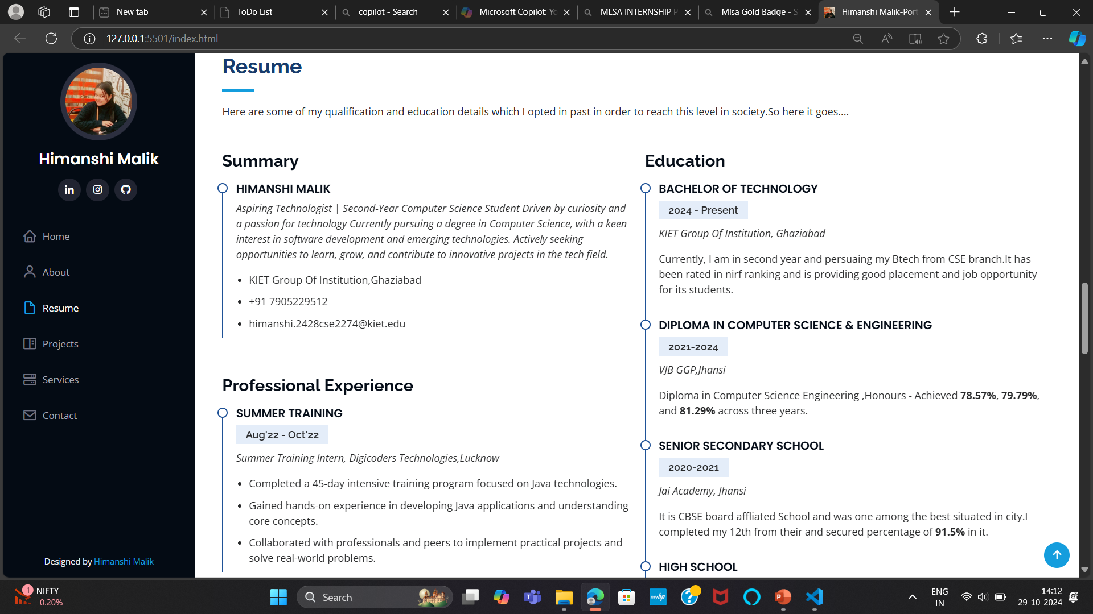
SNAPSHOTS

Slide 12
CONCLUSION
Summary
My MLSA internship has been an invaluable experience, allowing me to develop practical web development skills through hands-on projects.
Key Achievements
Successfully built a To-Do List application and a Portfolio Website, demonstrating my proficiency in HTML, CSS, and
JavaScript.
Learning Outcomes
Enhanced my understanding of front-end development, user experience design, and responsive web design.
Future Aspirations
I am excited to apply the skills and knowledge gained during this internship to more complex and impactful projects in
the future.
Acknowledgements
A big thank you to the MLSA program for this opportunity and to my mentors and peers for their support and guidance.

Slide 13
Thank you
HIMANSHI MALIK
CSE 2ND YEAR
202401200200005

